Slide 1
2022 Wheelwright Annual Meeting
December 5, 2022

Slide 2
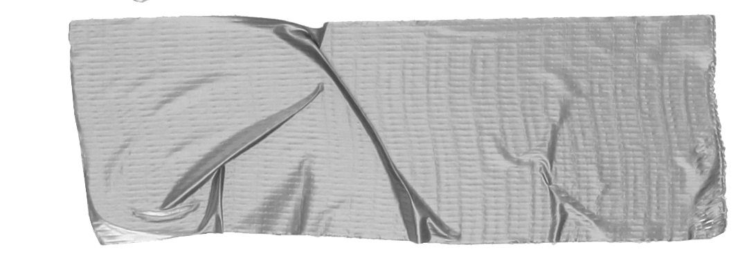
AGENDA
Roll Call
2022 IN REVIEW Review of projects
Design Updates
Updates approved by RA in 2022
Updates awaiting approval by RA
Design update changes proposed for 2023
Goals/Ideas for 2023
Replacement of parking lot - TBD
Review of parking in Wheelwright lot
EV charging stations
Erosion control
Reserve study analysis/discussion with community
Design updates
Pet waste stations
Lower cluster island landscaping
2022 BUDGET Review/2023 Budget Proposal Review financials from 2022
Proposed budget for 2023
Board Member Positions
2 board members terms’ are up

Slide 3
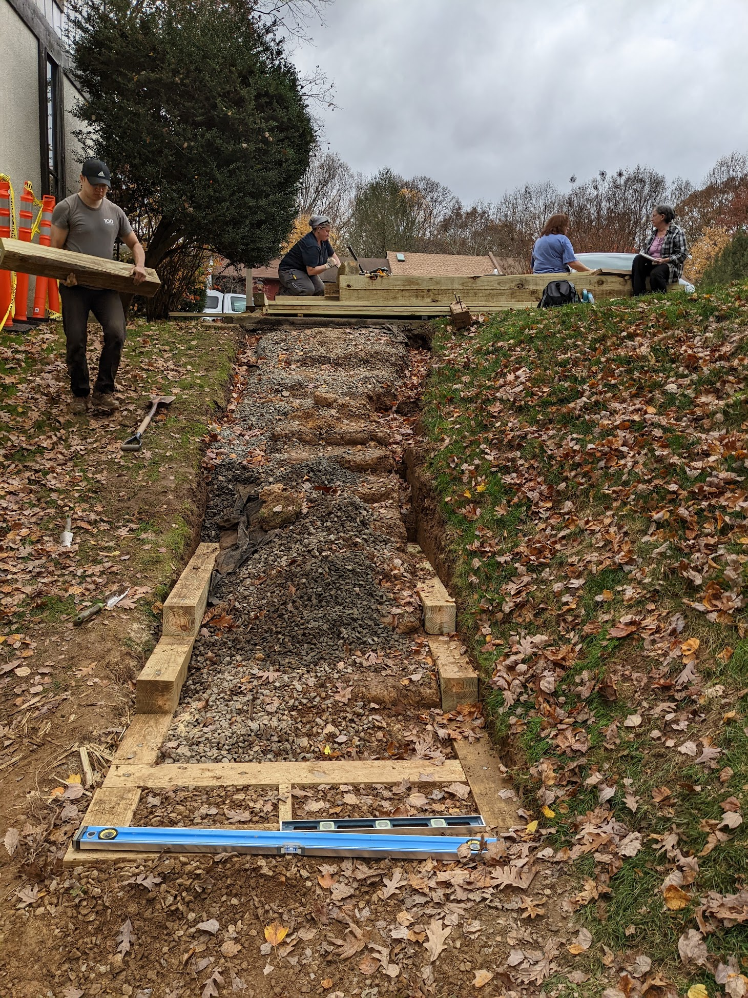
2022 In Review
Inflation - increase in prices for services and supplies
Erosion
Cluster clean up - installed erosion netting and native green and gold on slope next to 2231/tot lot.
Concrete
Upper cluster areas - focus has been to address areas that pose the greatest risk of tripping hazards
Curved sidewalk next to Wheelwright entrance/small area of sidewalk in front of 2226/2228.
Landscaping/Grounds Maintenance
Rebuild of lower cluster stairs by resident volunteers
Native plants around the cluster - many in areas around trees, slope by 2241, little free library - by resident volunteers
2 replacement trees in prominent areas.
Continuation of grass rejuvenation around common cluster areas

Slide 4
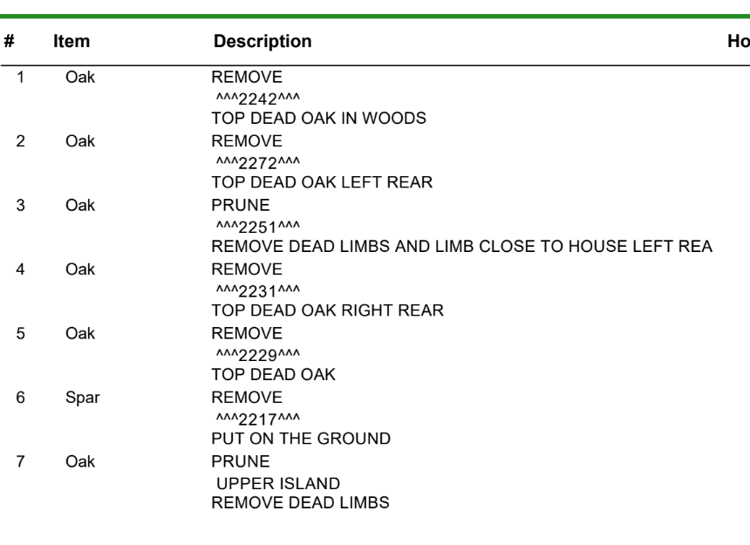
2022 In Review
Tree Committee (Michael Pendleton, Jeffrey Cai, Kerry Wingel)

Slide 5
2022 In Review
Removable speed bump installed - community feedback?
Ongoing: Community compost bin - community feedback?
What To Compost
Fruits and vegetables
Eggshells
Coffee grounds and filters
Tea bags
What NOT To Compost
Meat and Fish Scraps. ...
Dairy, Fats, and Oils. ...
Plants or Wood Treated with Pesticides/Preservatives.
Black Walnut Tree Debris. …
Diseased or Insect-Infested Plants. …
Weeds that Have Gone to Seed. ...
Nut shells
Shredded newspaper
Cardboard
Paper
Yard trimmings
Grass clippings
Houseplants
Hay and straw
Leaves
Sawdust
Wood chips
Cotton and Wool Rags
Hair and fur
Fireplace ashes
Charcoal Ash. ...
Dog or Cat Waste.
Plastics (including bags) even if they are “compostable”

Slide 20
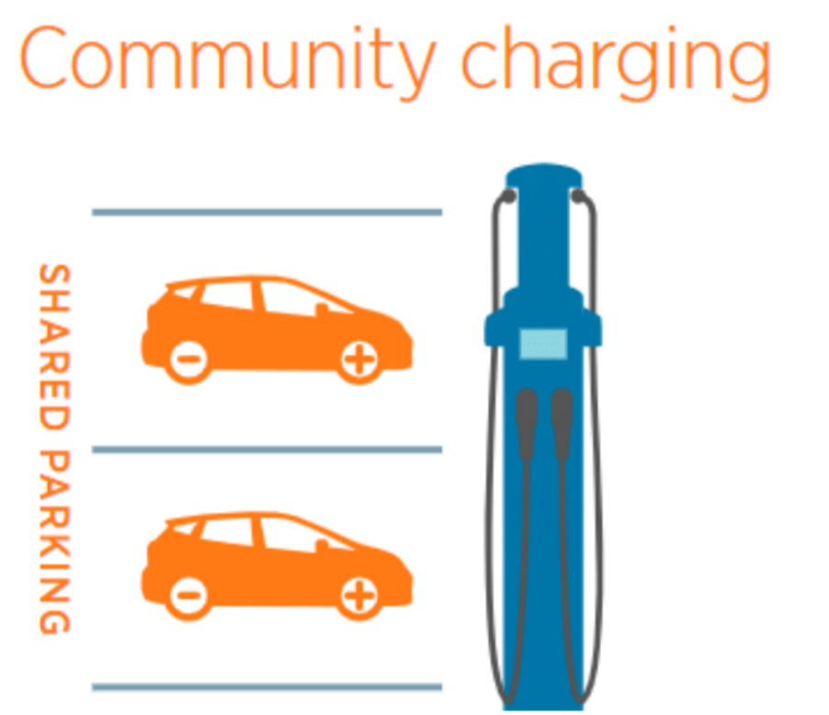
Goals for 2023
EV car charging
Charge Up Fairfax Pilot Program
Designed to help HOA communities install public use EV charging stations
Pilot program where 2 or 3 clusters in Reston will be the “guinea pigs” for this program from January through March of 2023.
Full roll-out of program after July 2023 in which all HOA’s in Fairfax county will be eligible.

Slide 21
Goals for 2023
EV car charging
HOA Exploration phase - it will be incumbent upon the HOA to review governing documents - Identify Possible Charging Locations - Survey residents - review funding options - submit predevelopment worksheet.
If selected, Charge Up Fairfax will begin Engagement phase including engineering site evaluation (paid for by county).
If feasible, then HOA would go into implementation phase - select general contractor and build. Charge Up Fairfax would rebate up to ⅓ of cost or up to $5,000.

Slide 22
Goals for 2023
EV car charging
Since public funds would be used for installation of chargers, the stations would need to be open to the public, not just residents. Restrictions and heavy fees for outsiders could be set up.
Engineering considerations - where are transformers in neighborhood. Proximity to charging space is ideal.
Estimates are ~$10-30,000 for EV charging station.
Do we have enough parking spaces?
RA also looking into installing stations on some RA spaces throughout Reston - probably Walker Nature Center.
County is also putting a lot of charging stations in public lots all around county.

Slide 23
Goals for 2023
EV car charging
Right to Charge Act passed by the Virginia Assembly in 2020
Because our parking spaces are all on common property (our cluster owns every inch of the parking lot), individual residents could install their own chargers on their reserved parking spot but:
Would need to submit the application as co-applicants with the resident and board
May need to get clarification from lawyer on who has ownership
Cluster and resident must come up with maintenance agreement
Legal guidance needed on a path forward

Slide 24
Goals for 2022
Repaving of Parking Lot
Why didn’t this get done in 2022?
Price of oil affected the Asphalt Price Adjustment Indices - since last January.
Finally starting to come back down again
Reserve study dedicated a large portion to parking lot assessment
Will it get completed in 2023?
That depends. Reserve study needs to be discussed with Mason and Mason.
If it does not get completed, it will definitely need to be crack sealed.
EV charging stations will play into the decision as well.

Slide 25
Goals for 2022
Parking in the cluster
Only registered cars will be allowed to park in the cluster (unregistered guests of residents will always be allowed to temporarily park in the lot as well; however, long term guests or frequent guests should register their cars with the cluster)
All vehicles must have current tags
Ideally, 2 vehicles/household in parking lot. Extra vehicles - Olde Crafts
Do we want to rethink parking lot - reserved parking spaces? Open up new spaces?

Slide 26
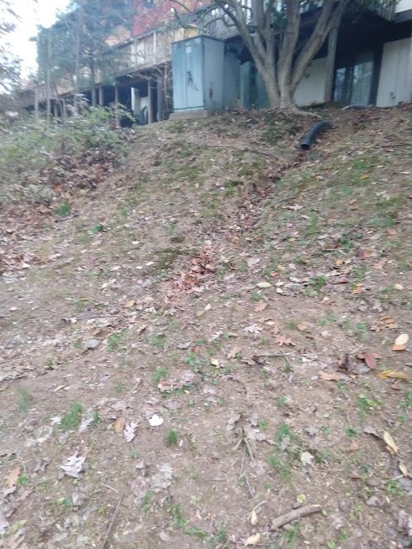
Goals for 2023
Continue to tackle erosion
Areas of concern 2250-2256 - rear of houses
Erosion control benefits the community in several ways:
improves drainage/ decreases sitting water and runoff into area streams and lakes
Repairs and prevents further wearing away of slopes
Stabilization of slopes can be achieved through planting of shade tolerant vegetation - specifically native plants as they have much longer roots that hold the soil in place
This area was a 2022 goal, but 2231 was addressed instead
Community project that could help us determine if stabilization of slopes can be addressed with ground cover plantings.
Results: we will have a better idea by spring/summer, but this area may require more engineering to mitigate erosion of slopes from drainage pipes.

Slide 27
Goals for 2023
Concrete
Patchwork maintenance of sidewalks on cluster property around the community
Continue to address tripping hazards
Alternate years addressing problem areas in lower vs. upper cluster
Community input welcome regarding areas needing to be monitored for possible replacement
Landscaping
Continue with common areas for grass rejuvenation
Rebuild wooden benches throughout the cluster - (this was a goal for 2022 but we replaced the lower cluster stairs instead)
Designing a well thought out landscaped area for the lower cluster island and installing replacement tree
Hiring smaller tree company to prune small trees

Slide 28
Goals for 2023
Tree Work
Tree Committee
Separate from the board/makes recommendations to the board who ultimately decide
Coordinates annual review of trees with arborist
Largely focuses on trees that are potential risks to life and property
Community members can reach out to board if they are interested in joining the tree committee

Slide 29
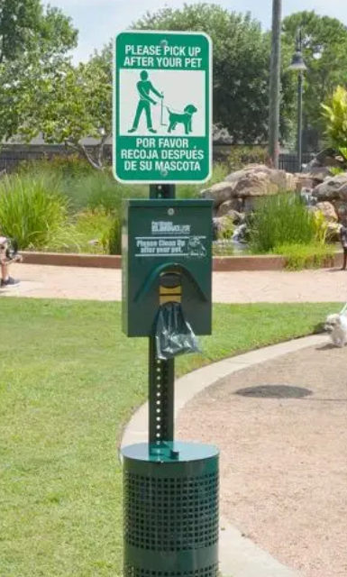
Goals for 2023
Pet waste stations
1 or 2 stations - one in lower, one in upper cluster?
Companies that will install and maintain the waste stations
Cost?

Slide 30
Goals for 2023
Reserve Study
Completed at the end of November by Mason and Mason
Due to the delay in receiving the report, we are holding off on a formal discussion at this meeting.
Board will review and post the results. Community members will have an opportunity to discuss and ask questions.

Slide 31
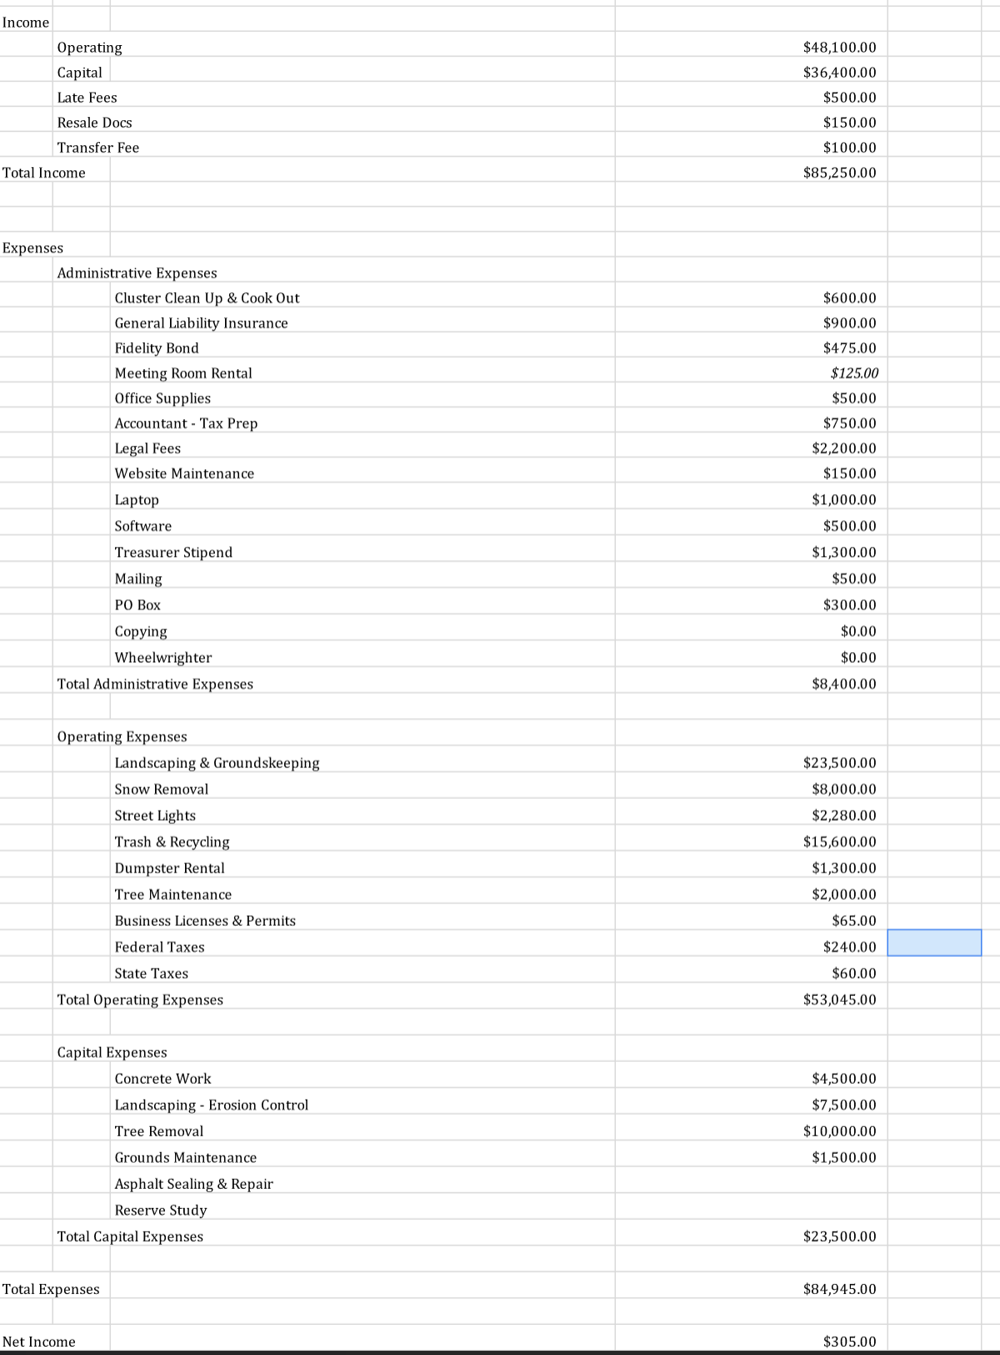
2023 Wheelwright HOA Proposed Budget

Slide 32
Topics for Discussion
Emails - newsletters - contact the board with your current email wheelwright.cluster.assoc@gmail.com
Community open forum
https://docs.google.com/forms/d/e/1FAIpQLSfeu4t_W-JA5ctkNH1V4od6W7SsSSa9-w5el3xBuZCAuS046A/viewform?usp=sf_link

Slide 33
2 board members are up for re-election. Both members would prefer to “retire” their board positions.
https://www.surveymonkey.com/r/NG56SLK
Please consider volunteering for a board position. Roles will be determined after the board has been voted in. We need new members so that we can entertain new ideas and keep the HOA moving in a positive, progressive, financially healthy direction.

